Slide 1
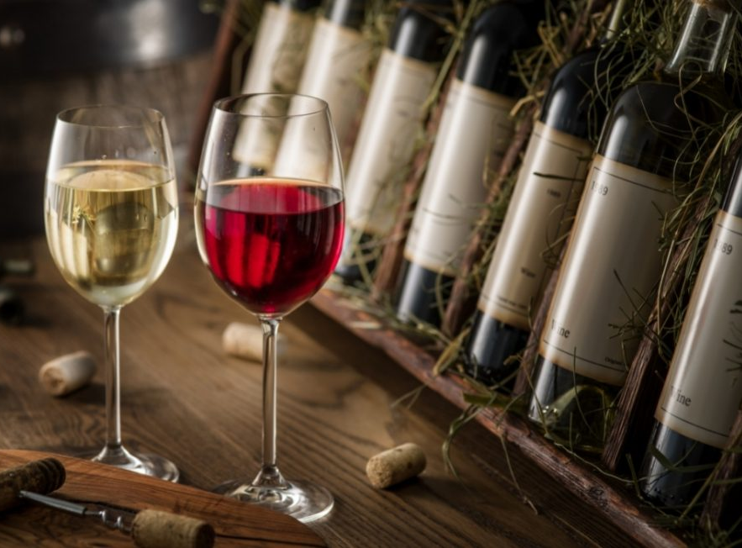
Module Number: COM4302
Module Name: Computer Science Fundamentals
Year/Semester: 2024-25 / April 2025
Task:2
By Iliyana Drobenova

Slide 2

Wine Quiz Questions and Answers: Cheers!
Sparkling, rose, white, and red – the world of wine is diverse with various tastes, flavors, and feelings. Let’s try the following wine quiz questions and answers to see how much you know about it.

Slide 3
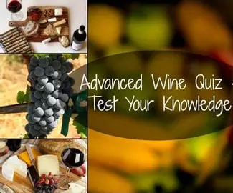

This quiz contents:

Slide 4
Flowchart diagram:
Correct?
start
Question 1
Users input
wrong1
correct1
Question 2
Rest of the quiz

Slide 5
Flowchart:
Start: The quiz launches in your Python environment. You're greeted with a welcome message that sets the theme: 10 wine-related questions coming your way.
Initialize :The code loads all 10 questions into a structured list. Each question has: A prompt (e.g., "Prosecco is produced in which Italian region?")Three options labeled A, B, C one correct answer used for scoring.
Question arrow: For every question the program displays the prompt and options. You input your choice (A/B/C).It checks your answer against the correct one. If right: You earn 1 point and get a “ Correct! "If wrong: It reveals the correct option with “ Sorry or Wrong!”

Slide 6
Flowchart:
Result :Once all 10 questions are answered your score is tallied. Based on score ranges, you get a personalized result:
10 Wine Expert 🌟
9 Enthusiast 🍾
5 Beginner 🍇

Slide 7
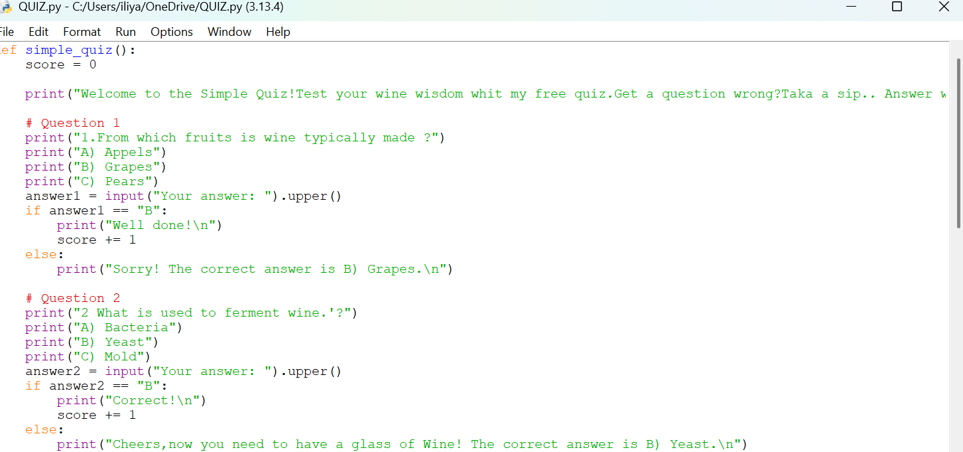
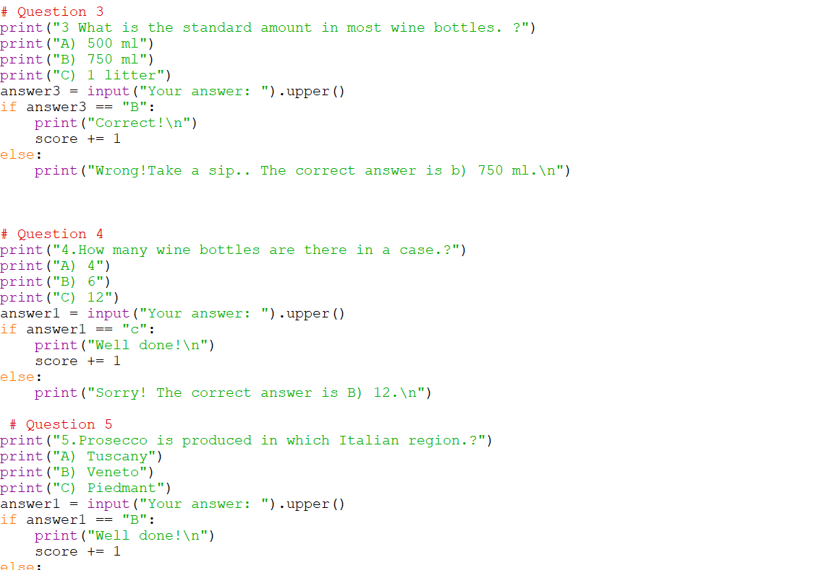


Slide 8
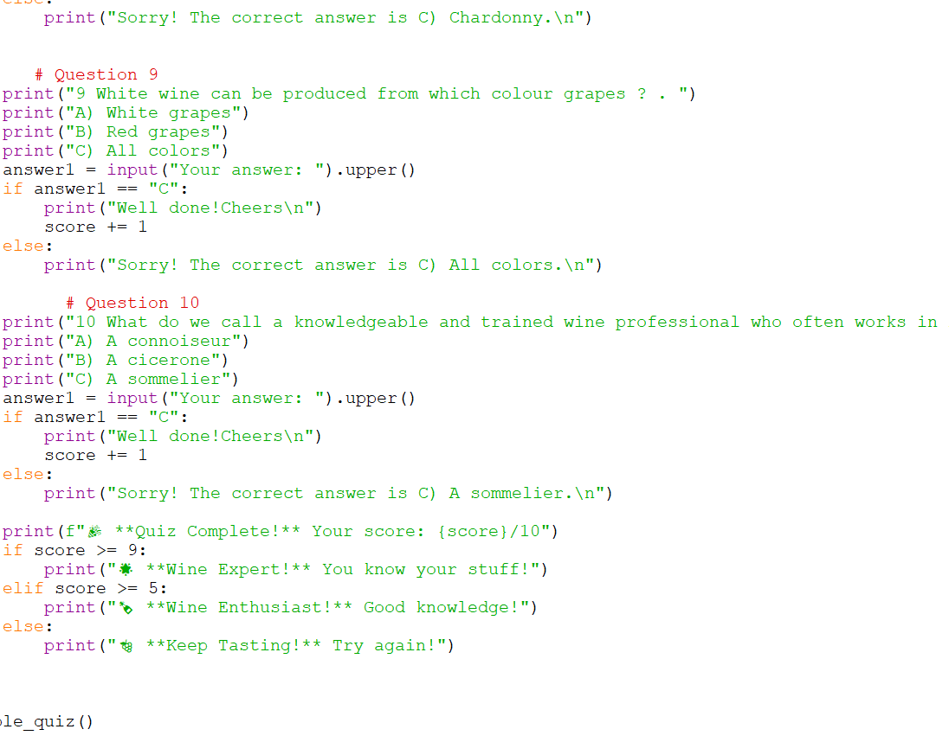
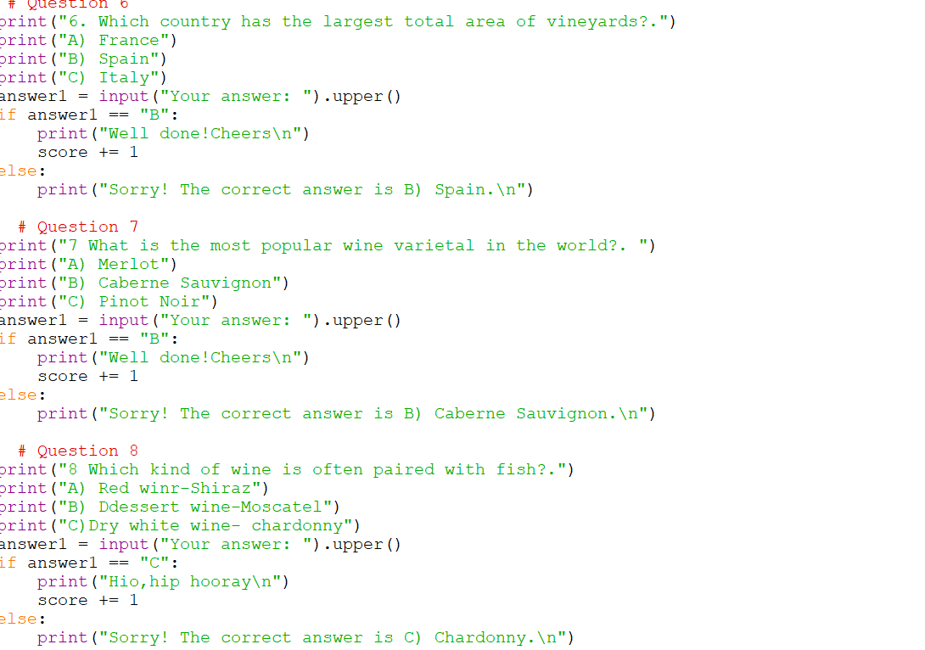

Slide 9
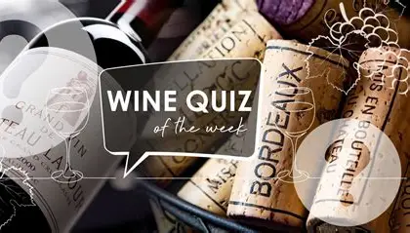
References:
Coates, C. (2008). The Wines of Burgundy. University of California Press.
Johnson, H., & Robinson, J. (2019). The World Atlas of Wine (8th ed.). Mitchell Beazley.
Maltman, A. (2018). Vineyards, Rocks, and Soils: The Wine Lover’s Guide to Geology. Oxford University Press.
Anderson, K. (2020). Which Winegrape Varieties are Grown Where? University of Adelaide Press
Goode, J. (2014). The Science of Wine: From Vine to Glass (2nd ed.). University of California Press

Slide 10
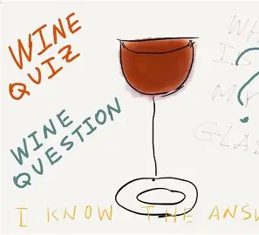


Slide 11


